Slide 1
Requests
Eric Prebys
FRS-003-009

Slide 2
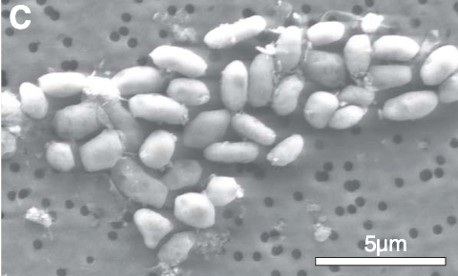
Arsenic Life (Mariana Perez Martinez)
The bulk of living matter is composed of carbon, hydrogen, nitrogen, oxygen, sulfur, and phosphorus.
In 2010, a paper published in Science purported to show that an extremophile found in Mono Lake, in California could use arsenic in place of phosphorus to sustain growth.
This led to an intense debate in Science.
Citations for the full comments are available at the retraction header.
Most claim that the conclusions are premature, given the observed results.
In 2012, two subsequent studies were published in Science that failed to reproduce the result (see this and this)
The interesting thing is that the policy at the time was to only retract papers in cases of deliberate misconduct or fraud, which no one was alleging in this case.
The policy has changed over the years to support retractions in cases “a paper’s reported experiments do not support its key conclusions, even if no fraud or manipulation occurred”
The paper was finally retracted under this policy in July, 2025.

Slide 3

“Potato Tree” (Adrian Chen)
The potato tree is a legendary tree at UCLA, which appears to be growing potatoes.
It’s popular on campus and has given rise to numerous legends:
The most common is that they were the result of a failed Cold War experiment to develop a new food source.
Some claim they are therefore radioactive.
In fact, the tree is a “sausage tree” (Kigelia Africana), native to Africa
Fruit are generally longer and skinnier than potatoes.
Used in traditional medicine
Raw fruit is poisonous to humans, but is made into an alcoholic drink in Kenya
The significance of this is that myths can sometimes persist, even in science. Examples
There’s no Nobel Prize in math because Nobel’s wife had an affair with a mathematician.
Fact: Nobel was never married. There’s no prize in Math because he thought it was too theoretical and there was already another math prize.
After winning the Nobel Prize in 1922, Niels Bohr got a house next to the Carlsburg brewery with a permanent beer tap.
Fact: Bohr did get a lifetime supply of free beer, but it was delivered the normal way.

Slide 4
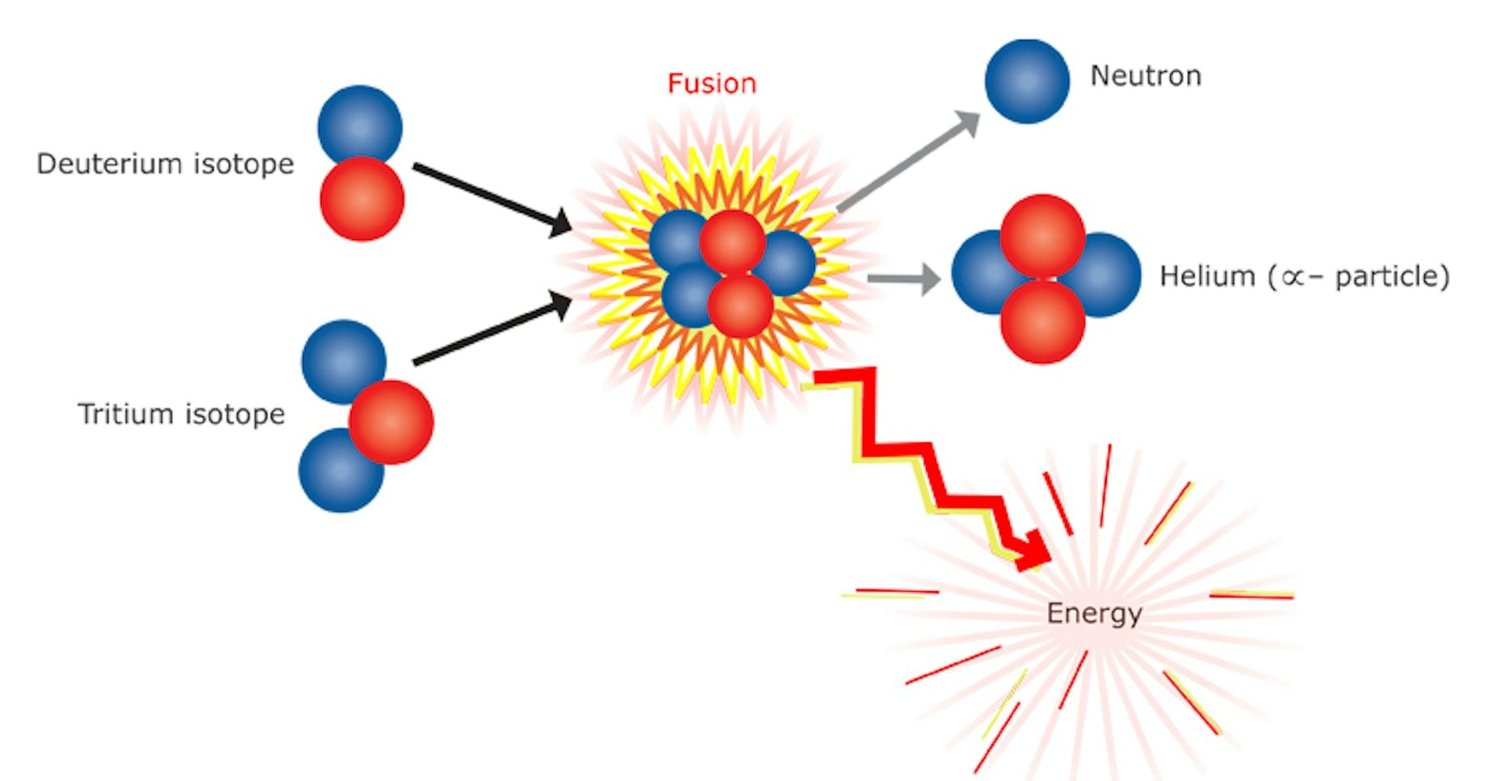
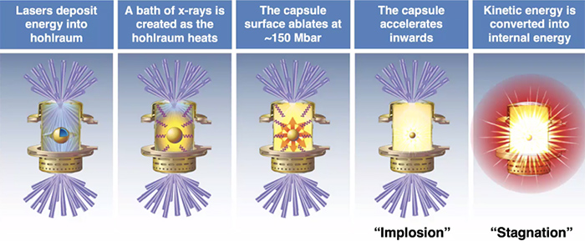
Nuclear Fusion Breakthrough (Aditya Naveen)
Specifically, the breakthrough in inertial confinement fusion announced at Lawrence Livermore National Lab
We discussed this a bit in the “Energy: No Such Thing as a Free Lunch” lecture
Fusion produces energy by fusing deuterium and tritium
While most attempts at controlled fusion use magnetic confinement to keep the nuclei close together, LLNL a system of 192 lasers to initiate the reaction
They are then “inertially confined” during the process

Slide 5
So What was the Result?
For the first time, LLNL observed more energy coming out of the reaction than was delivered by the lasers.
This is scientifically very exciting, BUT
In order to be a viable source of power, a fusion reactor would have to recover enough energy to at least provide the input power for the lasers (ie, the “wall plug efficiency”).
There is no concrete plan for energy recovery, but most schemes involve absorbing the neutrons on a lithium blanket and using the heat to drive a steam generator.
Let’s say a WAG of 50% efficiency.
Unfortunately, high power lasers are horribly inefficient
Only about 1% of the energy that goes into the lasers is delivered to the target!
So the system is still at least a factor of 200 away from “practical” breakeven.
And of course you would still like to have something left over to actually power something.
Even if it’s possible, inertial confinement fusion is still many decades away from being a practical power source.

Slide 6
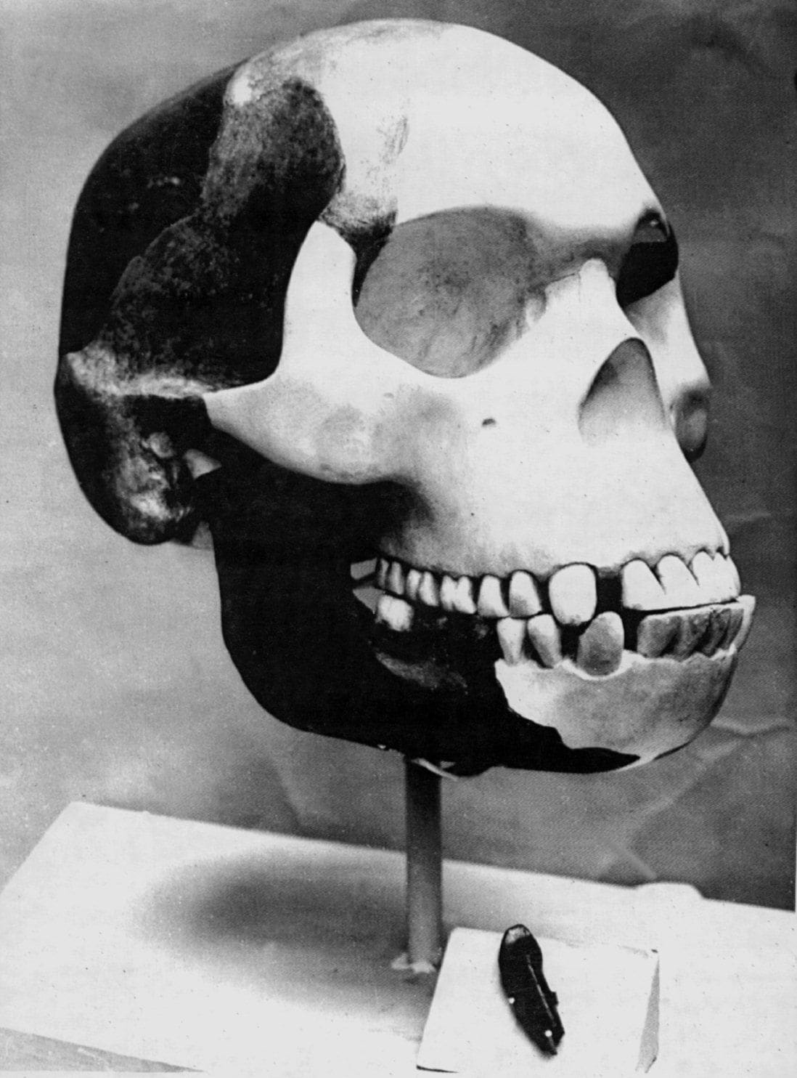
Piltdown Man (Nalin Storer)*
This is the OG 20th Century scientific hoax!
In 1912, amateur archeologist Charles Dawson found bone fragments in a gravel beds near Piltdown England.
The cranium appeared human, the jaw appeared ape-like, and the teeth were somewhere in between.
He passed the skull fragments on to his friend Arthur Smith Woodward, a paleontologist specializing in fossilized fish.
Dubbing it “Piltdown Man”, Woodward declared it the “missing link” between our apelike ancestors and us.
It favored the “brain first” model, in which humans evolved a large brain before developing a smaller jaw.
Also supported the idea that humans had evolved in Europe, which White people liked.
Dawson claimed to have found second fossilized skull nearby, but would not disclose the location.
Dawson died soon after, leaving Woodward to carry the torch.
This discovery became the cornerstone of his career.
Check out “Homo Decepticus” on the Cautionary Tales podcast.

Slide 7
Piltdown Man Goes Down
There were skeptics of Piltdown Man from the very beginning.
It was strange that he found two almost complete skulls and no other bones.
Over the years skepticism grew.
Further fossils favored the “diet first” model of evolution, in which humans evolved a smaller jaw before a larger brain.
No further fossils resembling Piltdown Man were ever found.
All other primitive fossils were found in Africa.
In 1953, and investigation by Kenneth Oakly, J.S. Weiner, and W.E. Le Gros Clark at the British Museum showed
The fossil was a forgery consisting of a human cranium, ape jaw, and ape teeth that had been filed down.
The fragments had been discolored to make them look older than they were.
For years, debate raged over who exactly had perpetrated the hoax, but an extensive study in 2016 showed it was almost certainly Dawson himself.
It turns out he had a long history of “discovering” interesting artifacts with questionable provenance.
Somehow everyone had missed this.
The lesson is that scientist can be overly trusting and should at least be open to the possibility of outright fraud rather than error.

Slide 8
Scientific Publications by AI (Mackenzie Reilly)
The use and consequences of AI in scientific publications is VERY important and timely, and it could easily be the basis for an entire class.
On the one hand, AI is a powerful tool that will not go away and has the potential to greatly enhance the impact a single person or group can make. Some recent scientific advances that have benefited from AI include.
AI designed proteins
Simulation on a scale not possible before
The development of “cool copper cavities” for particle acceleration.
AI-enhance drug discovery.
AI has even generated at least one complete, peer reviewed paper entirely on its own.
On the other hand, AI can be used to generate substandard publications in the interest of padding one’s CV.
In this case in point, AI generated letters were being sent to the editors of journals.

Slide 9
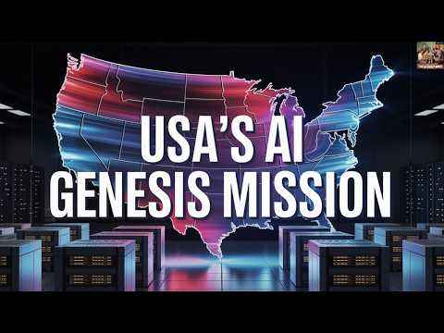
Things Will Only Get More Complicated
In that example, the letters were of demonstrably poor quality, but quality will improve.
You could imagine AI simply digesting existing papers, slightly rewording them, and then publishing them as original, flooding the world with recycled garbage.
The recently announced Genesis Mission – to the extent ANYONE understands what it actually is! - has as its goal an overarching AI platform that will incorporate ALL data from all labs in the US and then autonomously do analysis and produce results.
There are the worries about the environmental effects of AI, but this is (probably?) a small fraction of that.
There are bigger questions about the relationship between humans and machines.
I don’t have the answers, but these are questions that will loom large for your generation.

Slide 10
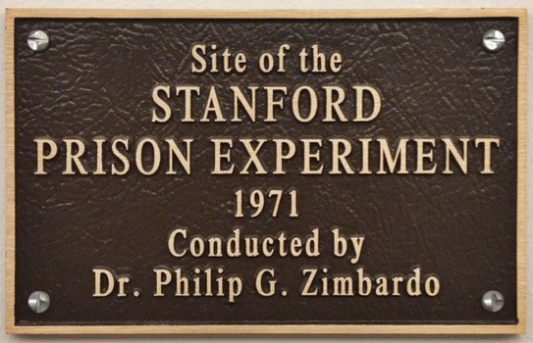
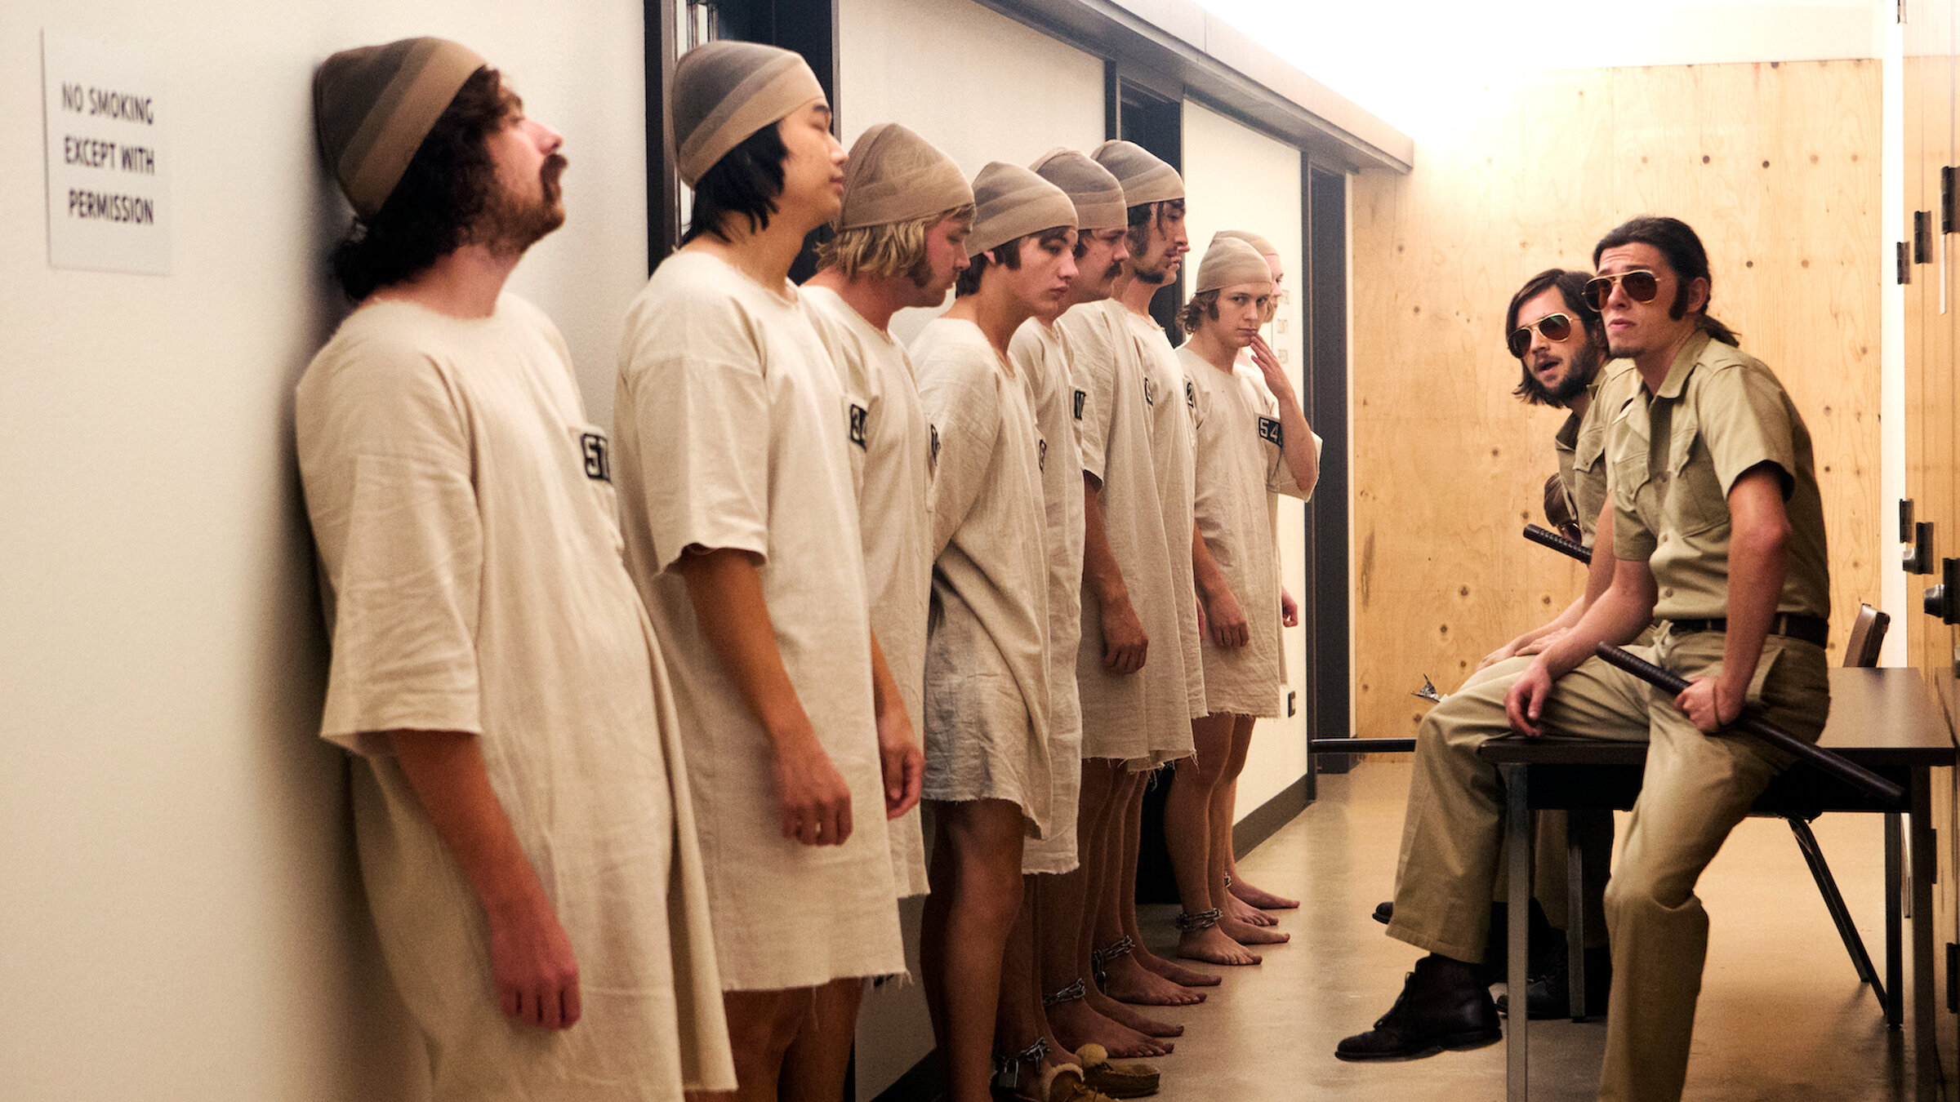
Stanford Prison Experiment (Dakota Becerra and Bianca Escutia)*
This is a famous experiment that I remember hearing a lot about in the 1970s.
In 1971, Stanford Psychology professor Philip Zombardio recruited 24 volunteers by offering $15/day for a two-week “prison simulation” in a local paper.
These were randomly assigned to be “prisoners” and ”guards”.
The “prisoners” were mock-arrested by real Palo Alto police and put into a prison.
The guards were told to “keep the prisoners from escaping”.
The project was funded by the Office of Naval Research (the same people who designed our |
cyclotron!) to study antisocial behavior.
Things quickly deteriorated and the both the guards and prisoners became increasingly violent.
The program was terminated after five days out of concern for safety.
*AKA “more bad science from Stanford”

Slide 11
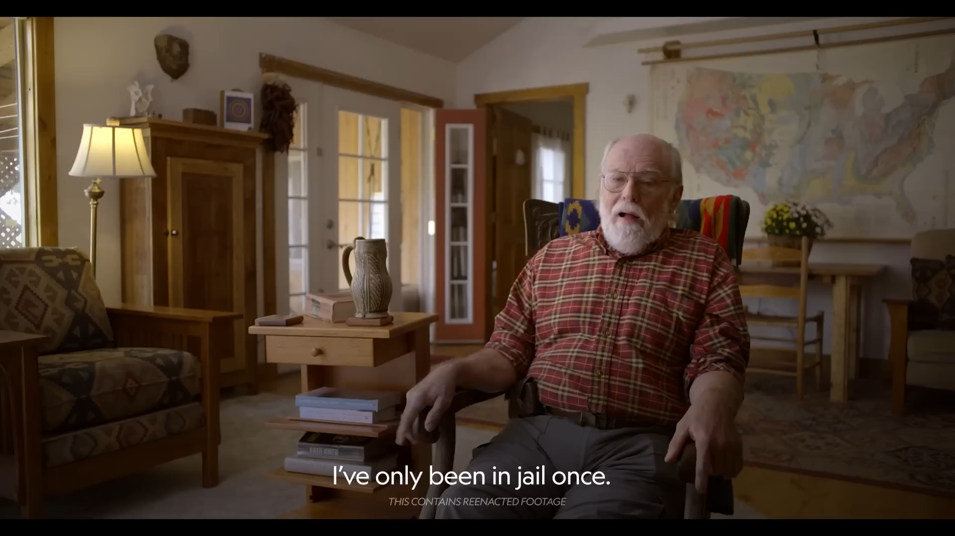
The Aftermath
Zombardio interpreted the results as a fundamental revelation about human nature.
Often mentioned in the same breath as the famous Milgram Experiment, which showed that people will administer what they believe is a lethal electric shock as long as someone else is willing to take responsibility.
Already successful, he became something of a celebrity, and continued to be consulted for decades.
He testified about the abuses by US personnel at the Abu Graib detention facility in Iraq.
But was it even real?
In addition to the obvious questions about the ethics of the test, criticism emerged early on that through a combination of selection bias and demand characteristics (i.e. making his expectations known), Zombardio had pushed the participants toward this behavior.
In 2016, Thibault Le Texier, a French researcher, in his book, Histoire d'un Mensonge (The History of a Lie) claims through interviews with participants that in fact they had been strongly coached as to how to behave.
Zombardio has denied this, but testimony of the participants seems to back Le Texier, as evidence by this recent documentary

Slide 12

Chiropractic (Yushan Fang and Luis Colinres)
From the definition:
a form of complementary medicine based on the diagnosis and manipulative treatment of misalignments of the joints, especially those of the spinal column, which are believed to cause other disorders by affecting the nerves, muscles, and organs.
Started in the 1890s by D.D. Palmer, who claimed that “subluxations”, or invisible misalignments of the spine, were responsible for a whole host of problems.
Chiropractors aim to cure these problems through “adjustments”.
There is some evidence to support that spinal manipulation and mobilization for mechanical low-back pain, some neck pain, and certain types of headaches.
There is NO evidence it can treat asthma, infections, ADHD, GI issues, or any of the other things that some chiropractors claim.
There are rare, but potentially serious injuries associated with chiropractic manipulations, up to and including paralysis!
There is a schism within the community between those who only support the skeletomuscular claims and those who embrace the more pseudoscientific view.
N.B. Osteopathy started out making similar claims to chiropractors, but eventually evolved in to more or less standard medicine.

Slide 13
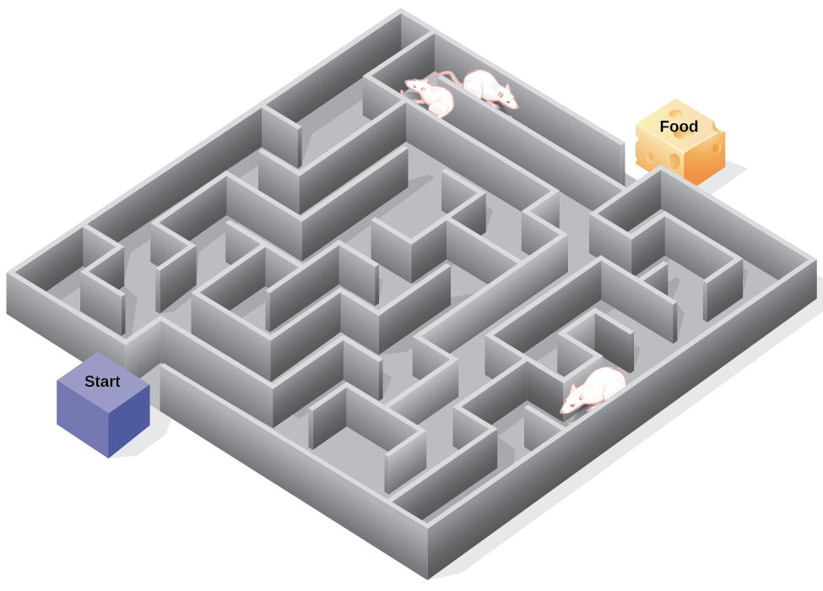
Transfer of Learned Behavior Through Brain Extracts (Havi Yadia)
This one is new to me.
In 1966, two papers claimed to show that memories could be transferred from one rat to another by transferring RNA from the brain (1, 2)
One group of rats was trained to run a maze in search of food.
They were then decapitated, their brain matter put in solution, and injected into other rats.
The claim is that the second group of rats could run the maze with little or no training.
This seems to have been a somewhat popular line of research back then.
Skimming through the papers, it looks like they were changing lots of variables in the test, which is some evidence of p-hacking.
While these authors claimed other positive results, and least two other groups tried and failed to reproduce them (1, 2)

Slide 14
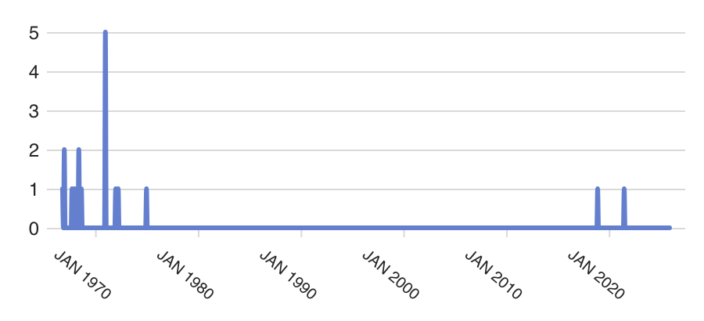
Status
Interest in this field seems to have died out.
Most of the papers are from the 1960s and 1970s.
The original article has only been cited 18 times, mostly before 1980
I think it’s fair to say this one is dead.
These are overview articles, which mention the result, but do not endorse it.

Slide 15
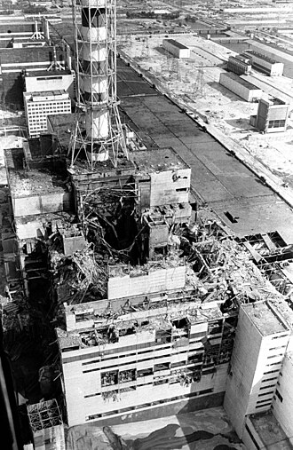
Chernobyl Series (Azul Castillo)
On April 26, 1986, Reactor #4 at the Chernobyl Nuclear Power Site in the Soviet Union (present day Ukraine)was performing a test to simulate cooling the reactor during a power outage.
Because of a series of mistakes and a design flaw in the reactor, this ended up causing and explosion and a meltdown.
This immediately killed two engineers and severely burned two others.
Of the 237 workers hospitalized, 134 showed symptoms of acute radiation syndrome (ARS), of which 28 died within three months.
Fatality estimates from fallout range from 100 to 9000.
The town of Pripyat was immediately abandoned and remains a ghost town to this day.
Radiation was detected in many other countries, and it was assumed the Soviets would simply lie about it, but they surprised everyone by (mostly) coming clean.
”Chernobyl Notebook” is the English version of the official Soviet public release.
Contains one of the most Russian lines I’ve ever read: “They put the IV needle in my vein. After about 2 hours, I began to feel vigor in my body. When the IV was finished, I stood up and began to look for a smoke.”
Gets most of the facts right, but blames some of the wrong people.

Slide 16
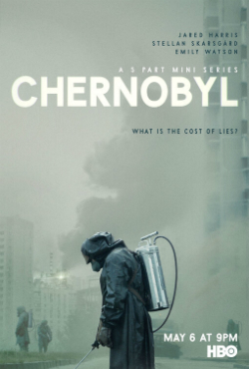
The HBO Chernobyl Miniseries
I consider the HBO miniseries to be a masterclass in how to tell a technically complex story in a compelling fashion.
Focuses on Valery Legasov (played by Jared Harris), who investigated the incident and later committed suicide.
Some good dramatic choices
Legasov’s assistant, Ulana Khomyuk (played by Emily Watson) is actually a composite of several real people.
Legasov never testified at the trial, which was a proper Soviet show trial with a predetermined verdict, but having him testify in the show was an excellent way to explain the disaster in detail to a lay audience.
Some minor errors:
The show implies a helicopter crashed due to radiation when in fact it hit a crane.
The show overstated the size of the possible explosion from the molten core leaking into the water reservoir below.
The claim that people watching from the “Bridge of Death” later died is an urban legend.
Some things that are incorrectly claimed to be errors:
Some have criticized the extreme condition of the firemen as overly exploitative, but it’s taken verbatim from eyewitness accounts.
Some have said they firemen themselves would not be radioactive because there would be no secondary activation, but this was contamination in their blood and lymphatic system.
In the end, the show got a lot more right than it got wrong.
The companion podcast is also very interesting and entertaining.

Slide 17
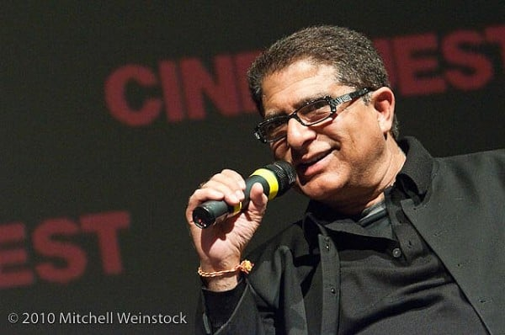
The Guru Fallacy (Emily Hines)
This one is right in my wheelhouse!
The articles submitted were:
“On the reception and detection of pseudo-profound bullshit”
“The Guru Fallacy: Exposing Deepak Chopra’s Claims With Critical Thinking”
“Professor Jerry Coyne explains why Deepak Chopra is nothing more than a fraud”
They obviously focus on Deepak Chopra, who was once a highly respected medical doctor, who taught at the medical schools Tufts University, Boston University, and Harvard University before becoming Chief of Staff at New England Memorial Hospital.
Later, he realized there was more money and fame in spouting New Age gobbledygook and he started spouting total nonsense.
His approach is two-pronged:
Profound-sounding statements that have no meaning. Examples:
"Attention and intention are the mechanics of manifestation.”
“Love is entangled in ephemeral fulfillment.”
“Orderliness meditates on spiritual molecules.”
Hijacking actual scientific concepts and using them in nonsensical ways
Particularly quantum mechanics

Slide 18
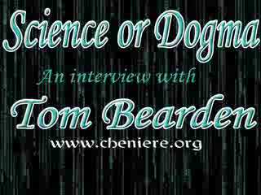
Don’t be Fooled By Jargon
PSA: If someone who is NOT a physicist starts to talk about quantum mechanics, run don’t walk away, and make sure you have your wallet!
Chopra loves to talk about quantum mechanics, a subject he clearly knows nothing about.
He wrote a book called “Quantum Healing” in 1987, which is total nonsense.
You can find a number of quotes from actual scientists about his notions here, but some highlights are:
"few people have distorted and defaced quantum physics more” – Dr. Sadri Hassani
"to a physicist, Chopra's babble about 'energy fields' and 'congealing quantum soup' presents as utter gibberish” – Prof. Chad Orzel
The main takeaways are:
Don’t be fooled by profound-sounding nonsense.
Don’t be dazzled by technical jargon.
Never pretend to understand anything you don’t because it sounds cool.
Thomas Bearden, notorious free energy crank.

Slide 19
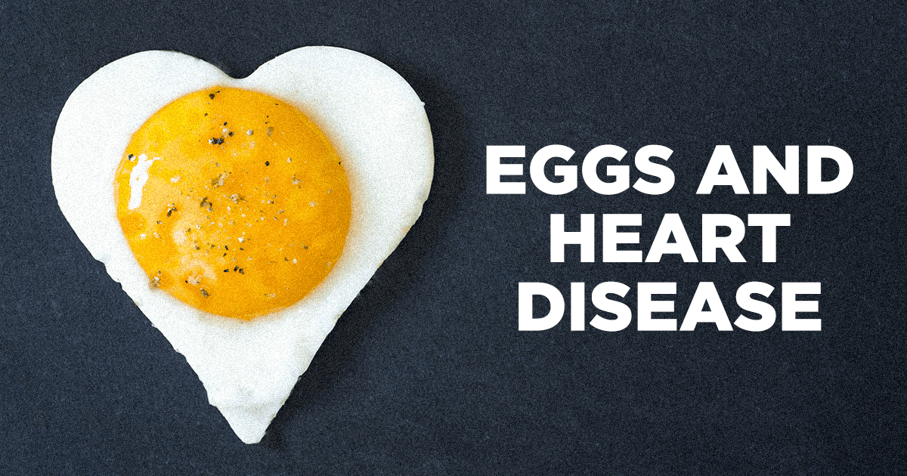
Egg Cholesterol and Heart Problems (Matthew Hecomovich)
The association of cholesterol with heart disease began in the 1950s
Because of their high cholesterol content, eggs became part of the discussion by the 1960s.
By the 1970s and 1980s, doctors began advising people to limit their egg consumption, in spite of little or no evidence of any danger.
There are two separate questions to answer:
Does the consumption of eggs increase the cholesterol in the blood?
Does that increase result in increased heart risk.
While some studies seem to indicate some increased risk, the general consensus now is that moderate egg consumption poses no significant risk in otherwise healthy people [1,2]
Although there is some increased risk for people with diabetes.

Slide 20
What Went Wrong and What Can We Learn?
Because eggs are themselves high in cholesterol, eggs were simply assumed to be a driver of blood cholesterol and heart disease, in spite of the lack of evidence.
Even if eggs cause a very slight increase in the risk of heart disease, other factors are much more important, including weight and general health
The importance of risk assessment.

Slide 21

Male Housework and Divorce (Kaitly Rist)
An article appeared in Today titled “Divorce rate higher for couples that share housework, study finds”
It references a Norwegian study, but when I tried to follow the link, I was (I think) told in Norwegian that the article could not be found.
In looking for the title and the author (Thomas Hansen), I found that the article had been summarized in numerous family law websites.
They all had the same non-working link, but a a little more detail.
For example, this one claims that the study showed that couples who shared chores are up to 50% more likely to be divorced that couples in which the woman does most of the housework.
This seems counterintuitive, but is it?
This is a good example of confusing correlation with causation.
If both people are doing chores, it more likely that both people are working, and therefore in a better financial position to get divorced.
Also, a household in which the wife does most of the work might indicated a more traditional background, with more aversion to divorce.
Some of the comments in the articles suggest that the original paper acknowledged these things, but that has been lost in the game of telphone.
This goes back to our “science in the media” discussion.

Slide 22
MKUltra (Julian Quiroz)
We already discussed MKUltra in class in the Science and Politics lecture, but here’s a little more.
It was an illegal program begun by the CIA in 1953 with the goal of developing methods of mind control to turn people against their governments
Think “Manchurian Candidate”.
This was also another one of their comical failed attempts to kill Fidel Castro.
As has frequently been the case, the CIA destroyed many of the records, so we’ll never know everything, but what we do know is pretty bad.
The program ultimately focused on LSD (with and without consent), but also investigated electroshock, torture, and sexual abuse:
Much of this was done a foreign “black sites” to avoid US laws.
People we know took part in MKUltra research:
Poet Alan Ginsberg
Author Ken Kesey
Grateful Dead Lyricist Robert Hunter

Slide 23
MKUltra (cont’d)
People who may have taken part:
Crime boss Whitey Bulger
Robert F Kennedy assassin Sirhan Sirhan
Charles Manson
MKUltra was shut down in 1973. In the end:
They never succeeded at mind control.
They never did any science
They never developed a truth serum.
They just hurt a whole lot of people
*read the book ”CHAOS: Charles Manson, the CIA, and the Secret History of the Sixties” by Tom O'Neill

Slide 24
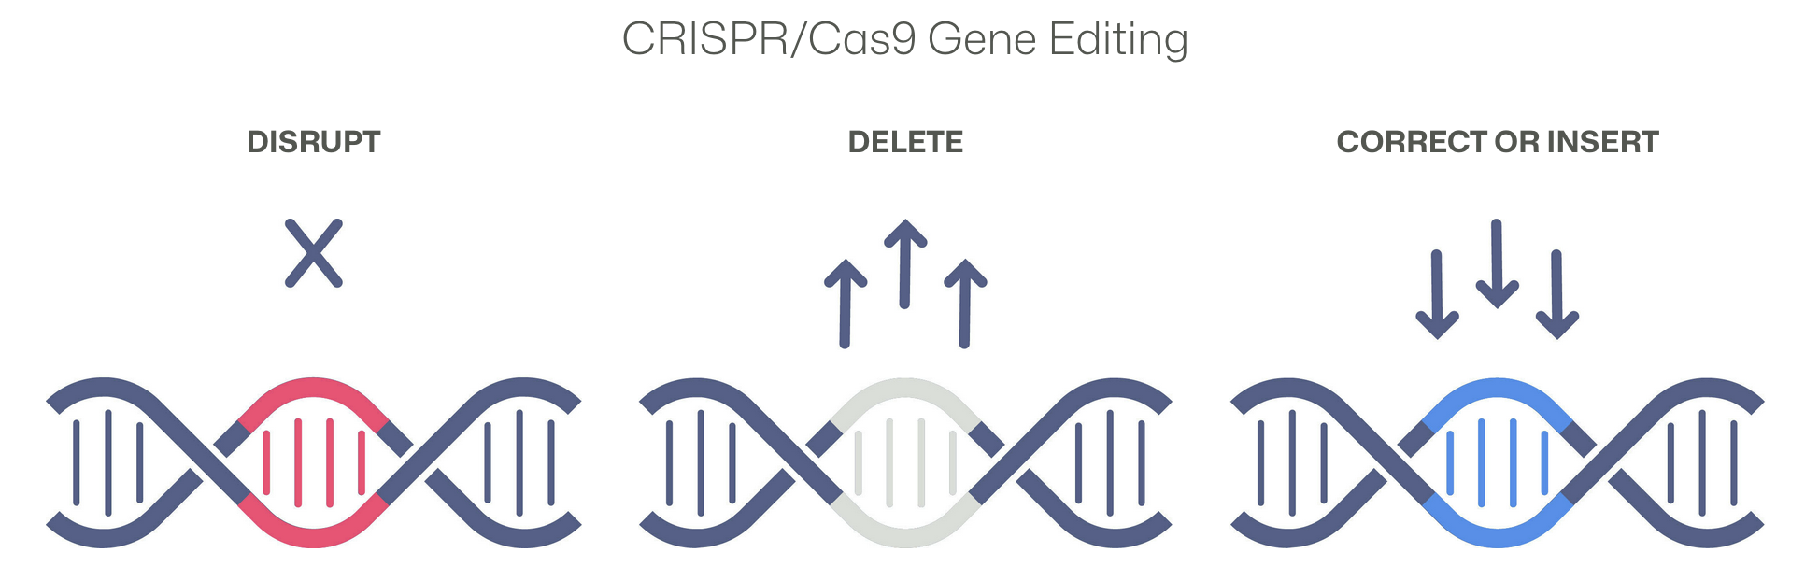
CRISPR Genome Therapy (Silvia Pujol)
CRISPER-Cas9:
CRISPR: “Clustered Regularly Interspaced Short Palindromic Repeats” of genetic information that some bacteria use as part of an antiviral system
Cas9: a CRISPR-associated (Cas) endonuclease, or enzyme, that acts as “molecular scissors” to cut DNA at a location specified by a guide RNA
Together these are used for a revolutionary new technique in gene editing
Many people have contributed to this, but primary credit for its success is given to Jennifer Doudna and Emmanuelle Charpentier , who shared the Nobel Prize in Chemistry for it in 2020.
It opens up many exciting possibilities.

Slide 25
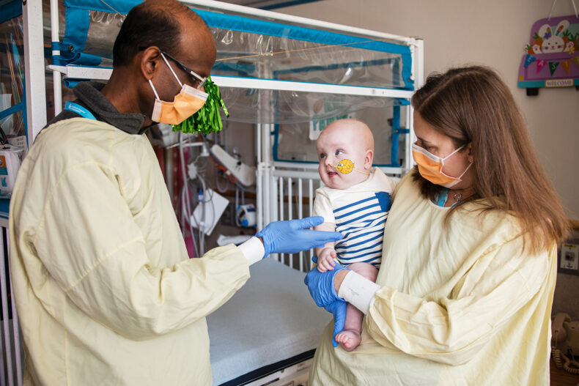
First Success of CRISPR-Cas9 Editing
Earlier this year, CRISPR-Cas9 gene editing had its first success.
”KJ” was born with a rare genetic disorder that him from processing food.
The disorder has a 50% mortality rate in the first year.
He was put on a heavy drug regimen and a liver transplant list.
In just six month a custom gene editing protocol was developed and applied.
So far, it seems to be working with no adverse effects.
If it proves successful, this is fantastic news, but it raises some important questions:
What are the risks involved in moving this quickly? In this case, the danger was enough to justify the risk, but what about a less lethal disease.
As we discussed in the eugenics lecture, custom gene editing has the potential to go beyond curing disease and defects and into the realm of make “superior humans”. Are we ready for the ethical implications?

Slide 26
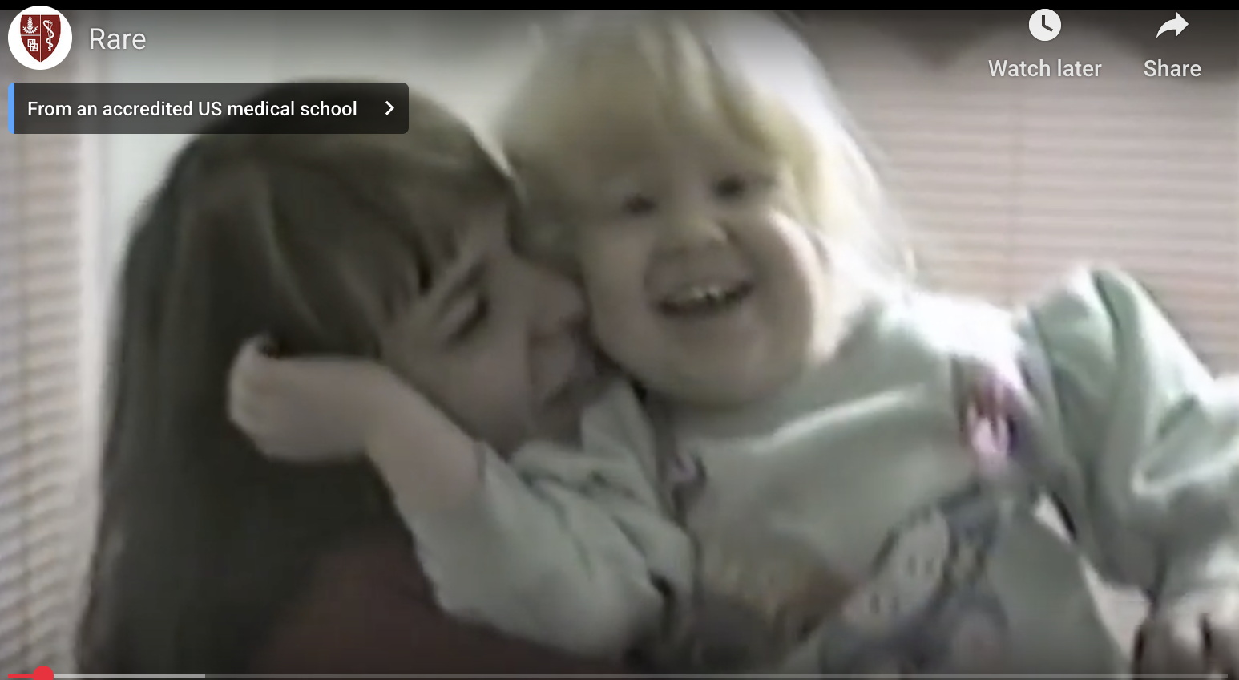
Hermansky-Pudlak Syndrome (Kelly Zhang)
RARE is a documentary being developed about the case of Donna Appell, whose daughter Ashley suffers from a rare genetic disorder known as Hermansky-Pudlak Syndrome, which causes
Albinism
Bleeding disorders
Cellular storage disorders in including pulmonary fibrosis,
Because it is so rare, there has never been much of a push for a cure or treatment, so the mother began to gather all the people in the US who had the disease (ultimately numbering about 100) to form an advocacy group, which has convinced the NIH to start a clinical trial.
This case highlights the fact that medical advances are often driven by passionate advocacy rather than abstract reasoning.
There is currently no cure for this disorder, but the gene editing discussed on the previous slide is certainly a promising candidate.

Slide 27
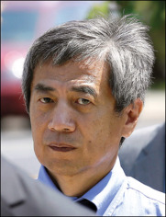
Falsifying HIV/AIDS Research (Giselle Cabello)
In 2012, Dong-Pyou Han, and Assistant Professor at Iowa State University published a paper claiming that the HIV-vaccine he was working on had produced “broadly neutralizing antibodies (bnAbs)” in HIV infected rabbits, indicating it was a promising path of research.
As a result, his team was awarded $19M in grant money.
In 2013, it was found that he had in fact, injected human antibodies into the rabbits to yield fake positive resuts:
This has blown past “Good” and “Bad”, right to “Ugly”.
In 2014, he was indicted on four felony counts, and in 2015, he was sentenced to 57 months in prison and given a $7.2M fine.
I think he got off too easy.
As I’ve said before, science is based on the honor system, and nothing is more sacred than honesty.
Behavior such as his reflects badly on all of us.

